Slide 1




Price Drop Alert
A technology for modern day discount shopping…..
BY :
Sahil Vijay Patil - A07
Shubham Sohanlal Jain - A21
Sehej Umesh Chitale - A22
Price dropped !!!
www.amazon.com

Slide 2

TERNA ENGINEERING COLLEGE, NAVI MUMBAI
DEPARTMENT OF COMPUTER ENGINEERING
Price Drop Alert
T.E(Comps)/Sem-VI/ Div-A
Sahil Vijay Patil A07
Shubham Sohanlal Jain A21
Sehej Umesh Chitale A22
Under the guidance of
Prof. Vishwajit Gaikwad
Academic Year
2023-24

Slide 3
index
CONTENTS | PAGE NO.
INTRODUCTION | 3
2. LITERATURE SURVEY | 4
3. PROBLEM STATEMENT | 6
4. OBJECTIVE | 7
5. SCOPE | 8
6. OUTCOME | 9
7. PROPOSED METHOD | 10
8. S/W AND H/W REQUIREMENTS | 11
9. SOFTWARE DEVELOPMENT MODEL | 14
10. TIMELINE CHART | 15
11. UML DIAGRAM | 16
12. CONCLUSION | 17
13. REFERENCES | 18

Slide 4
ABSTRACT
The "Price Drop Alert" project offers a solution to the challenge of fluctuating prices on e-commerce platforms like Amazon.
This web-based tool enables users to track specific product prices and receive notifications when they drop to user-defined thresholds.
Using Java, HTML, CSS, and Spring Boot, the application integrates web scraping techniques with the Amazon API to extract product information from Amazon's web pages.
User-friendly features allow input of product URLs and desired prices . With the help of API provided by Amazon, we can track the price of product.
Ultimately, the project aims to enhance the online shopping experience by providing timely price drop notifications to users.

Slide 5
INTRODUCTION
In the digital age of e-commerce, platforms like Amazon play a pivotal role in our daily lives, offering a wide range of products with ever-changing prices.
Our project, the “Price Drop Alert" will address the challenge of fluctuating prices, enabling users to monitor and analyze specific product pricing on Amazon.
This web-based tool will track the price of the product given by the user and it will notify the user whenever the price drops to the threshold price which is also given by the user.
This project will make the user not check the price of a product again and again, whenever it drops they will be notified.

Slide 6

LITERATURE SURVEY
Sr.no. | Paper name | Author name | Summary
1. | Title: Service Providence of Online Price Tracker for the Product Year :- 2021 | Dr.S.Muthusundari , Dr.S.Selvakanmani , Dr. S.Pratheepa , P.Kishore Kumar . | The journal paper introduces a web application addressing challenges in tracking flash sales on e-commerce websites. Users can set desired prices for products, and the application notifies them when the product reaches the specified price. The system utilizes web scraping, Beautiful Soup, and Angular for efficient tracking, offering advantages such as notification accuracy and user convenience.

Slide 7
2. | Title: E-commerce product price tracker Year :- 2021 | Dr. G Madhusudhan, Nitin Gopalakrishna Bhat, Sahana Venkatraman Patgar, Chandan N A, Bharath S V | The paper presents an E-commerce product price tracker application that addresses the challenge of dynamic pricing changes occurring every 10 minutes. Utilizing web crawling techniques, the system fetches real-time prices and notifies users when the product reaches their desired threshold. The 3-tier architecture includes a presentation tier (HTML, CSS, Bootstrap), application tier (.NET), and data tier (MySQL). The study references related works on web mining, dynamic pricing schemes, IoT-based price comparison, and regression models for price prediction, offering insights for system development and improvement..

Slide 8

PROBLEM STATEMENTS
E-commerce websites often offer flash sales with short durations, making it challenging for users to manually track product prices. Existing systems with price notifications are limited to certain websites, causing inconvenience for users who shop on various platforms. The need arises for an automated solution that works across diverse e-commerce websites, notifying users when a product's price reaches their desired threshold.
This project aims to address these challenges by developing a web application that utilizes web scraping and notification systems to enhance the user experience in online shopping.

Slide 9

OBJECTIVES
The main objectives of the “Price Drop Alert" project are as follows:
To Develop a web application which automates the tracking of product prices on AMAZON e-commerce websites.
To Integrate user-friendly features, allowing users to input the URL of a product, specify their desired price, and provide contact details for notifications.
To Utilize request packages to send HTTP requests and retrieve web page content, ensuring compatibility with websites storing information in HTML format.

Slide 10


SCOPE
The project will focus on enhancing user convenience by automating the tracking of product prices during flash sales on e-commerce website only for Amazon if API is available.
The project aims to cater to users who seek specific price points for products and desire timely notifications through E-mail only.
This Photo by Unknown Author is licensed under CC BY-NC

Slide 11
OUTCOME
1. Users will experience a streamlined online shopping process, eliminating the need for manual tracking of product prices.
2. The web application will provide accurate and timely notifications through email when a product's price matches the user's specified threshold.
3. Increased user satisfaction and engagement with online shopping platforms, fostering trust and reliance on the developed solution.
4. The project will contribute to the broader understanding and implementation of web scraping techniques for extracting information from Amazon website structures.

Slide 12

PROPOSED METHOD
User Input: Users will provide the URL of the product they want to track and the desired price threshold for receiving notifications.
Amazon API Integration: The project will integrate with the Amazon API to fetch real-time data about the product. This API provides access to various product details and pricing information, ensuring accuracy and reliability.
Comparison and Notification: Once the current price is obtained, the application will compare it with the user-defined threshold price. If the current price drops below the threshold, the user will be notified via email or push notification, depending on their preferences.
User Interface: The project will have a user-friendly interface where users can easily input the product URL and desired price threshold. They can also manage their alerts and preferences within the application.

Slide 13
Database Management: The application will maintain a database to store user product information, and Threshold price. This allows for efficient tracking and management of price alerts.
Automation and Scheduling: The application can implement automation and scheduling features to regularly check for price updates according to user preferences. This ensures timely notifications without the need for manual intervention.
Security and Privacy: To ensure user data security and privacy, the application will implement appropriate measures such as encryption for sensitive information and secure authentication mechanisms

Slide 14
Software requirements :
Frontend Development :
HTML5: Used for structuring web content.
CSS3: Used for styling and layout.
JavaScript (ECMAScript 6): Used for dynamic and interactive features on the client side.
Backend Development :
Spring Boot: Used to create robust and scalable Java-based backend applications.
Thymeleaf: A modern server-side Java template engine for web and standalone environments.
Java Development Kit (JDK) 8 or later: Required for Spring Boot application development.

Slide 15
Database :
MySQL 5.7 or later: Relational database management system for storing product and user data.
Web Server :
Apache Tomcat: A widely used open-source implementation of the Java Servlet, JavaServer Pages, and Java Expression Language technologies.
Integrated Development Environment (IDE):
IntelliJ IDEA or Eclipse: Preferred IDEs for Java and Spring Boot development.
Web Server :
Apache Maven: Used for project management and build automation.

Slide 16
Hardware requirements :
Server:
Minimum 2 CPU cores and 4 GB RAM for hosting the Spring Boot application.
Sufficient storage space for database storage and application files.
Database Server:
Meets the system requirements for MySQL.
Considerations for scalability based on the expected database size and usage.
Client Devices:
Any device with a modern web browser (Chrome, Firefox, Safari, Edge).
Responsive design to support various screen sizes, including desktops, tablets, and smartphones.
Network:
Internet connectivity for users to access the application.

Slide 17
Software development model The software development model we are going to use is AGILE DEVELOPMENT MODEL
Adaptability: The Price Drop Alert project may face evolving requirements and priorities. It allows for flexibility in accommodating changes throughout the development process.
User Feedback: Regular feedback from potential users, can be incorporated quickly, ensuring the final product meets user expectations.
Continuous Delivery: It enables continuous integration and delivery, allowing for the frequent release of features and updates, which is essential for a dynamic project like Price Drop Alert.
Collaboration: It promotes collaboration among cross-functional teams, fostering better communication and cooperation among frontend, backend, and database development teams.

Slide 18
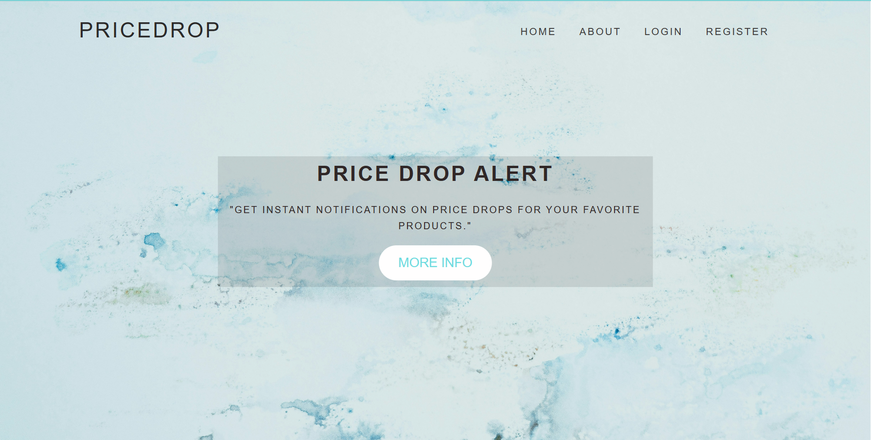
Implementation

Slide 19
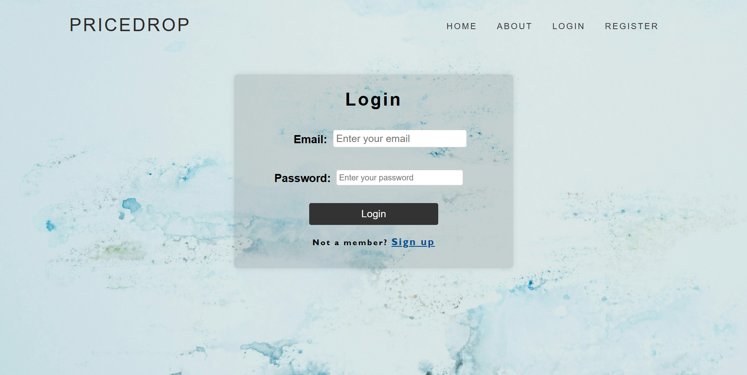

Slide 20
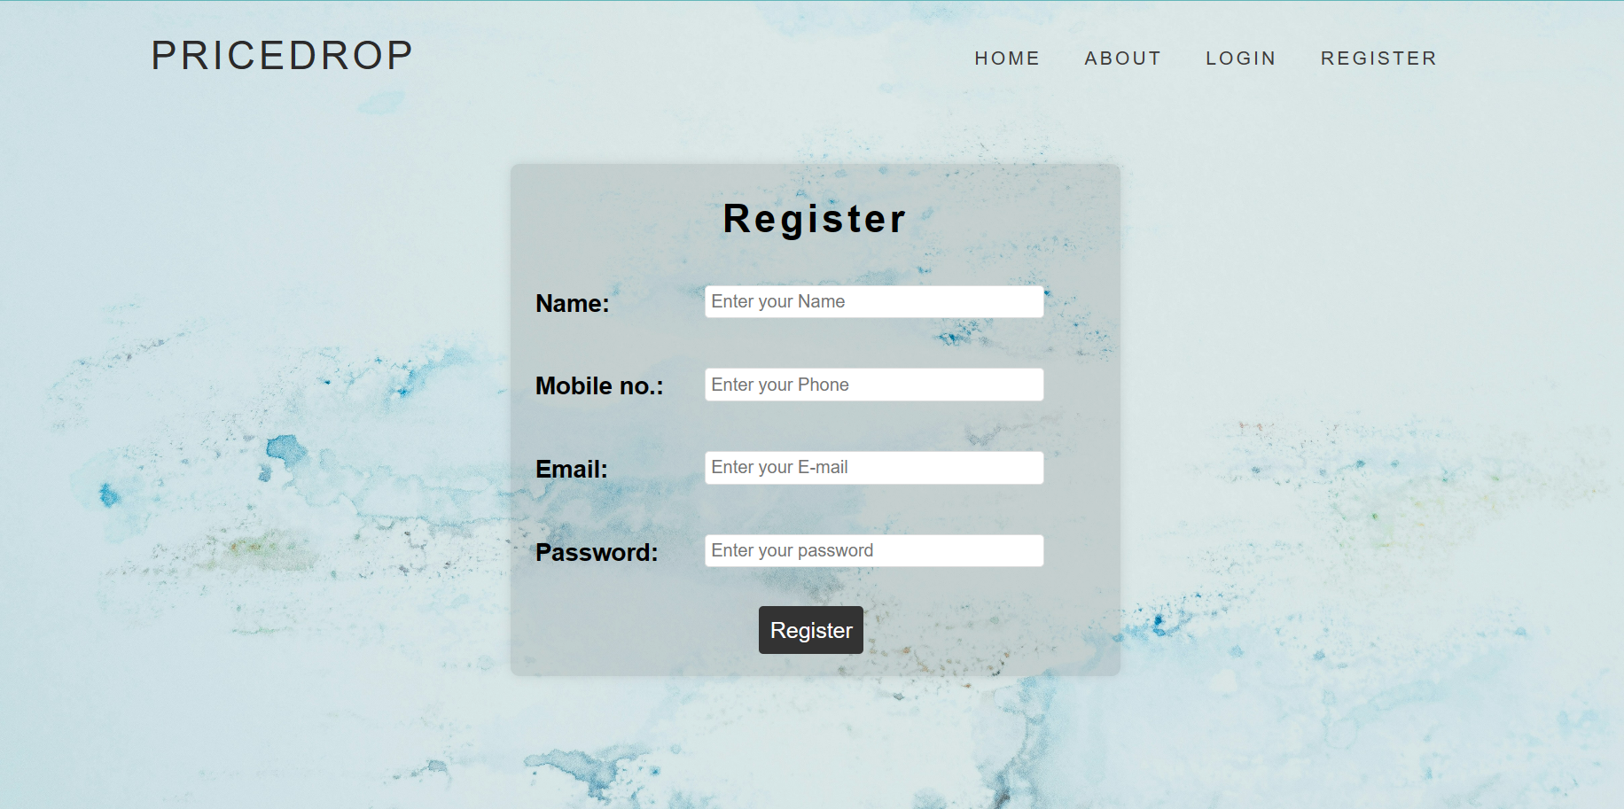

Slide 21
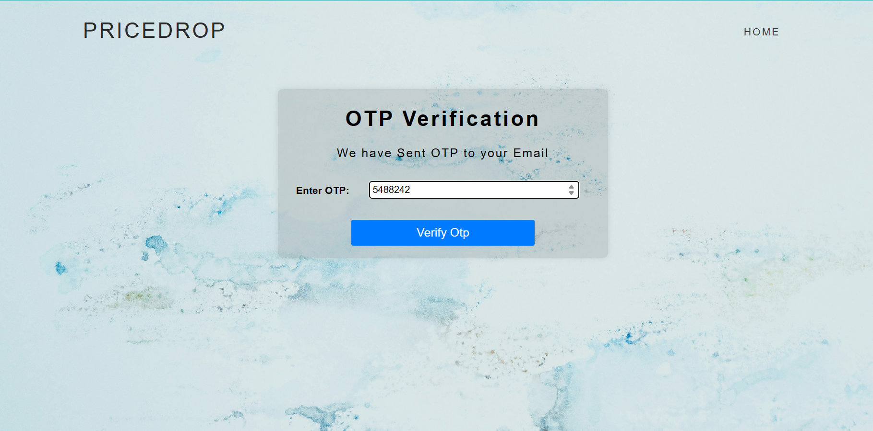

Slide 22
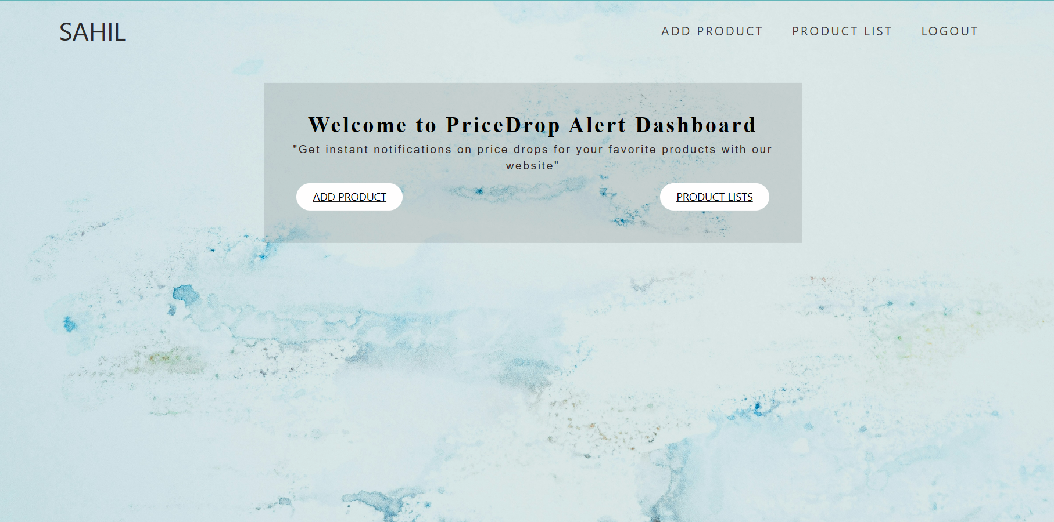

Slide 23
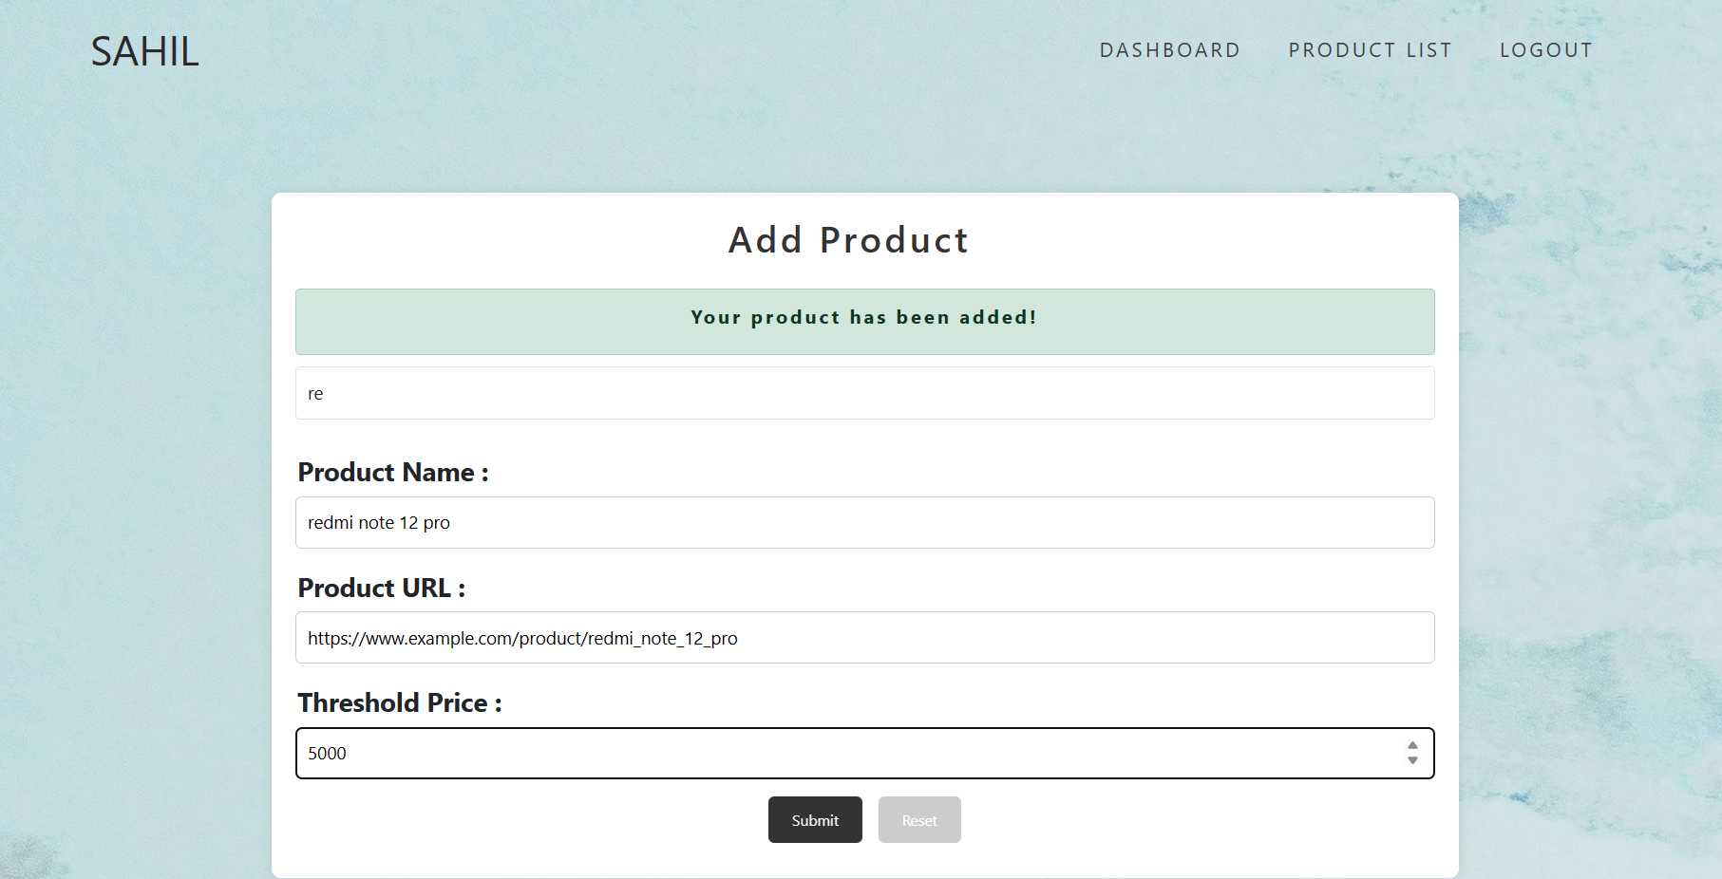

Slide 24
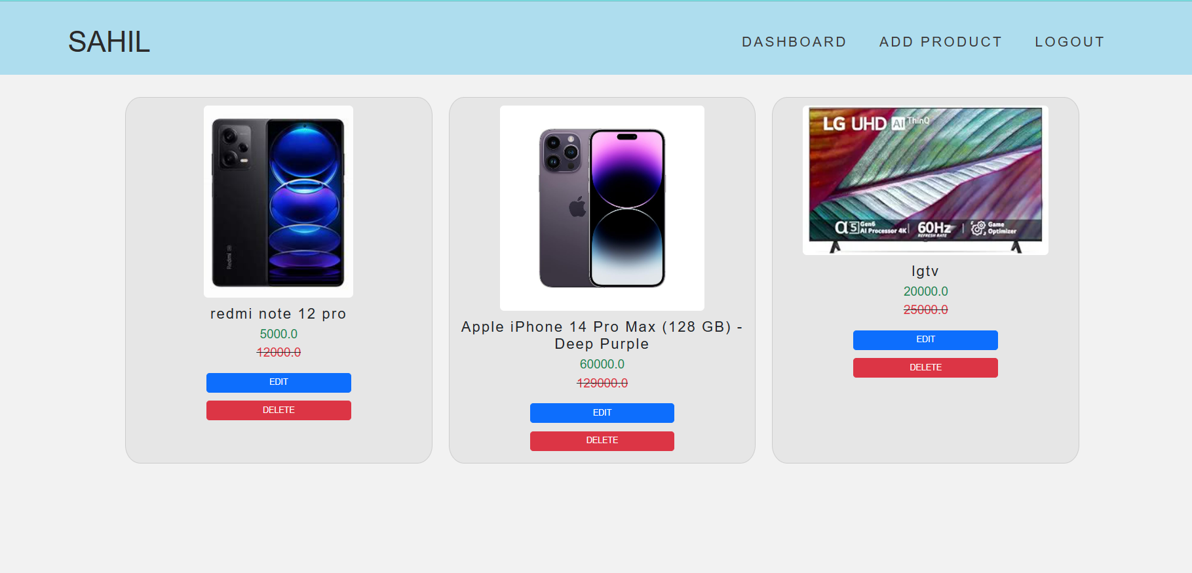

Slide 25
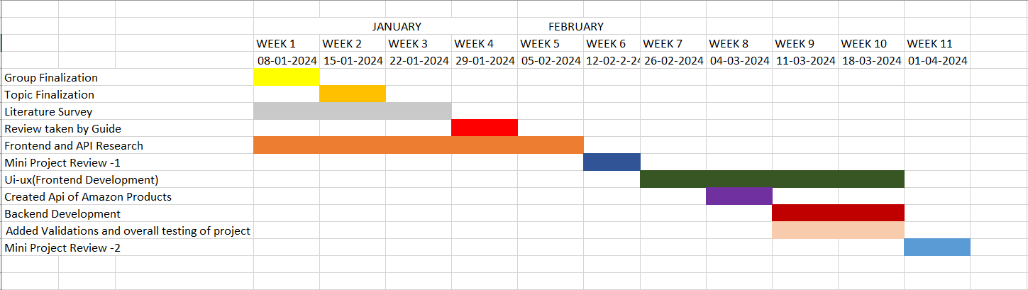
TIMELINE CHART

Slide 26
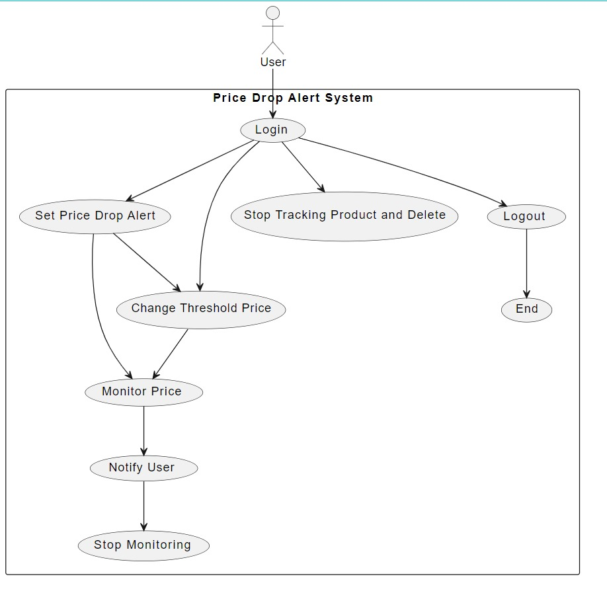
UML use case Diagram

Slide 27
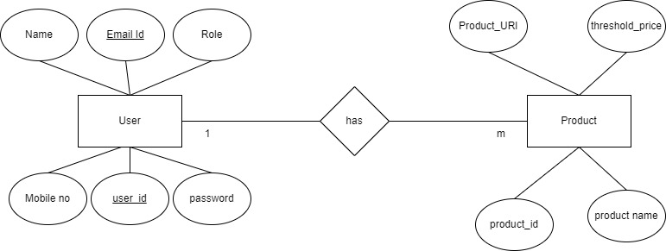
ER Diagram

Slide 28
CONCLUSION :
Our Price Drop Alert project will serves as a valuable solution for customers seeking to maximize savings on their desired products.
our project will offer a user-friendly interface and efficient backend processes to ensure a smooth and reliable experience.
With the potential to revolutionize how users approach online shopping, this project will stands as a testament to the power of technology in enhancing consumer empowerment and satisfaction.

Slide 29
REFERENCES
[1] Moe, Wendy W, Peter Fader S. Dynamic conversion behavior at e-commerce sites. Management Science. 2004; 50(3):326335.
https://www.researchgate.net/publication/227447618_Dynamic_Conversion_Behavior_at_E- Commerce_Sites
[2] Chen, Sandy C, Gurpreet Dhillon S. Interpreting dimensions of consumer trust in e-commerce. Information Technology and Management. 2003; 4(2-3):303-318. https://www.researchgate.net/publication/313019347_Modelling_and_Testing_Consumer_Trust_Dimensions_in_E-commerce
[3] Mahadevan, Balasubramaniam. Business models for Internet-based e-commerce: An anatomy. California Management review. 2000; 42(4)
https://eprajournals.com/IJSR/article/1210/download
[4] Miyazaki, Anthony D, Ana Fernandez. Consumer perceptions and of privacy and security risks for online shopping. Journal of Consumer affairs. 2001; 35(1):27-44. https://www.researchgate.net/publication/227629661_Consumer_Perceptions_of_Privacy_and_Security_Risks_forOnline_Shopping

